Slide 1
Implementing Third-Party Learning Resources to Support Employee Retention and Skill Development
Remberto Jimenez, Ed.D.
Veronica E. O’Neill, Ed.D.
NEDLA November 29, 2022

Slide 2
Introduction
PANDEMIC BEGINS
THE GREAT RESIGNATION
IMPACT TO L&D
Notes:
Rem
Since the start of this decade the world has changed dramatically both in terms of our personal lives and our work lives. The COVID-19 pandemic has for better or worse changed the way that we interact with each other and the ways that we utilize technology to support these interactions. The workplace was no exception it too had to change and evolve its strategies around employee retention and employee upskilling; These became an immediate necessity thanks in part to the great resignation.
In many ways the world of learning and development has always been on the forefront of change. However, I think we can all agree that the change that we saw in the great resignation has definitely put a new light in terms of supporting employee needs and creating workplaces for them to thrive and be engaged.
I like to think of the L&D function as one that changes with the times and addresses the learning needs of the organization in a variety of ways. Addressing the current fallout of the pandemic and the great resignation will continue to drive organizational changes in the future. But in the here and now, we can support key initiatives , like employee retention, and change the way that we operate to solve for both current and future needs.
Today I’m going to share with you what strategies could support this next phase of the learning and development function across organizations both big and small.

Slide 3
Introduction
48M
Quit their jobs in 2021
8.6M
Quit their jobs in Jan/Feb 2022
94%
American retailers are having issues filling vacancies
https://www.edsmart.org/the-great-resignation-statistics/
Notes:
Rem
Why must L&D evolve and be both nimble and strategic? Regardless of whether you are the L&D function for the entire organization or for a single business unit or division, employee retention is everyone’s business in an organization. Practically every organization has lost employees during the great resignation. Now the goal of finding new talent and retaining the ones you have come to the forefront especially as we continue to see talent leaving their current roles.
To put this in context, in the US alone 48 million people quit their jobs in 2021 8.6 million left their jobs during the first two months of 2022 more importantly 94% of American retailers are having issues failing vacancies.
Some people decided to change careers; others quit their job on the spot with no plan in place to consider. And in other cases, other employees saw this as an opportunity to either seek promotion or find new jobs where they can be engaged and use their skills to the best of their ability. So, organizations began a variety of different retention programs some of those retention programs varied from both compensation, benefits, as well as just creating more inclusive and empowering environments for all of its employees. However, there was also one additional element that needed to be included and that is the learning and development function.

Slide 4
Learning is one key to employee retention
This Photo by Unknown Author is licensed under CC BY-SA
Notes:
Rem
The Learning and development function has been a critical component to workplaces for centuries. It’s just that what’s considered workplace learning has evolved significantly to meet the current demands of organizations. This can be said to be due in part to the advantages that the current technological environment affords us. The personal computer changed the workplace forever; Wifi has changed the workplace as well. The use of smartphones and apps have also changed what it means to learn in the workplace. But one thing remains clear for any employee value proposition that is developed to support employee retention efforts, is that a learning and development strategy must be included in this solution set. More importantly it’s about taking what you’re already doing in the learning and development function and evolving it to address the needs that continue to evolve over time. again, learning and development has always been a critical part of the workplace as we’ll see on our next slide as Doctor O’Neill talks a little bit about the history of workplace learning.

Slide 5
History
Easel.ly
Pixabay.com
Notes:
Ronnie

Slide 6
Learning in the Workplace
Cairns and Malloc (2011), define learning “as the outcome of an enabled active intentional interactional engagement in experiences and thinking” (p. 9).
Hase and Blaschke (2021) describe learning as a “just in time phenomenon where opportunities to learn must be harnessed when the occasion presents itself, regardless of whether we are looking for them or not” (p.81).
O’Connor and Lynch (2011) note how an empowered, engaged individual is a productive individual; an alienated or stagnate individual simply does not care” (p. 421).
Notes:
As you can see from the previous slide, learning can take on many different forms. I do want to define learning based on Cairns and Malloc’s definition, which is as an outcome of enabled active intentional interactional engagement and experiences and thinking. As L&D professionals, we see learning as an active process and we see learning in the workplace as a set of intentional experiences to support knowledge and experiential acquisition of key skills. Learning is intentional in that employees engage with the learning because it could be critical for them to do their job; it could be a regulatory or mandatory requirement for compliance purposes; but it could also be intentional in supporting the development of key skills that will take them to the next level in their careers.
Moreover, it’s important that we also consider learning in the context of empowering employees potentially setting them up to be potential candidates for future roles in the organization. The reason I also look at it from this perspective is based on Hase and Blaschke description of learning. In their view, learning is a just in time phenomenon where opportunities to learn must be harnessed when they occasionally presents itself regardless of whether we’re looking for them or no. Thanks in part to the pandemic, we have seen many role vacancies and many cases where employees have had to take on additional responsibility. For some, there’s been multiple opportunities for just-in-time learning and one-on-one coaching. But not all employees may receive the coaching or training needed to support them in their new roles. More importantly it’s important for us to also consider the fact that now more than ever we need to empower our employees by provided with the tools and the resources to support their new expanded responsibilities.

Slide 7
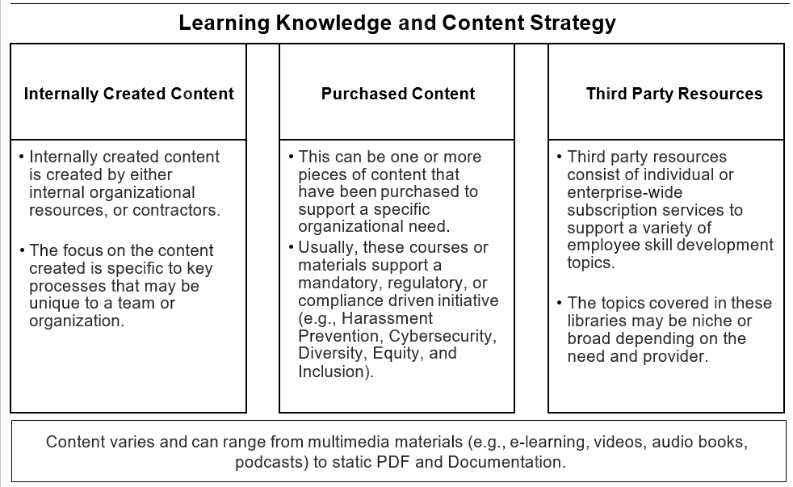
Created by Jimenez & O'Neill for the upcoming book: Current Trends in Cybersecurity & Educational Technology (2023)
Notes:
Rem
However just offering learning and development is not enough. One of the things that you’ll need to be able to do is to look at your program and come up with a learning knowledge and content strategy. This is something that I’ve implemented in my current role that Clear Channel outdoor.
More importantly it was a necessity in order for me to address the various learning needs and requirements for each of the different departments and employees in the organization. These three key pillars should be part of a holistic strategy: internally created content is exactly what it sounds like; its content that is created internally by key employees whether it’s by subject matter experts, an instructional designer in the learning and development function, or it could be a employee who is trying to address a current gap or need in the organization.
Purchased contact focuses on content that is usually meant to support a specific set of organizational needs this can be mandatory training regulatory training or compliance driven initiatives such as harassment prevention, cyber security, diversity and equity, and inclusion. Purchased content can also be specific courses ebooks or even access to documents that can support key skill sets in the organization.
Finally, you also need a third party resource strategy this is where you look at both individual and enterprise wide subscription services to support a variety of employee skill development topics the topics covering these libraries can be niche or broad depending on the need and provider. Combined together these three key pillars support a variety of different needs.

Slide 8
8 Learning and Development (L&D) Trends to Watch in 2023
Upskilling & Reskilling for the Digital Workplace
Content Repurposing
In-App Experiences
Learning in the Moment of Need
Microlearning
Knowledge-Sharing Ecosystem
Behavioral Data
Real-Time Employee Feedback
https://whatfix.com/blog/learning-development-trends/
Notes:
To further this point, let’s look at some of the projected trends to watch in 2023 for learning and development professionals. The ones that I would like to draw your attention to are the upskilling and reskilling for the digital workplace, content repurposing, learning in the moment of need, microlearning, and knowledge sharing ecosystem. Each of these elements combined relate to the importance of having a holistic learning content knowledge strategy to support the learners of your organization.

Slide 9
Multimedia in the Workplace
Learners can gain a better understanding of a topic when content is presented with both video and pictures, but not by words alone (Mayer, 2021, p. 3; Lawson & Mayer, 2021; Mayer 2014).
People learn better with interactive materials; they are also more engaged and motivated in the learning process when compared to those receiving non-interactive (“passive”) instruction (Chen & Catrambone (2014); Chapman et al., 1999).
Learning technologies offer many conveniences over standard instructional materials in areas such as portability and information access (Chen & Catrambone, 2014).
Notes:
Ronnie

Slide 10
Government
Notes:
ronnie

Slide 11
COVID-19
Notes:
ronnie

Slide 12
YouTube
Notes:
ronnie

Slide 13
Third Party Resources (Not Exhaustive)
LinkedIn Learning
ellomi
Pluralsight
MOOCs (i.e., Udemy/edX)
360Learning
EmTrain
Skillshare
Opensesame
Notes:
Rem
When it comes to third party resources there are many platforms and offerings from an array of different providers. Some of these providers are focused on very specific niche content, some of them tend to have broad levels of information that could appeal to a mass audience. Regardless here’s a list of some of the different third party resources that are available again this list is just a sampling of all the different providers or you can either purchased individual licenses or in some cases individual courses, and in other cases you may be able to access for a fee enterprise-wide solutions to support your organizational needs. The benefit of some of these platforms is that they contain so much content and so many courses focusing on a variety of different topics that it does provide organizations with the budget the opportunity to really let employees direct their learning by accessing the courses that are relevant to their own personal growth needs. In other cases there may be mandatory courses or even suggested courses to address key needs whether it’s HR specific safety courses or even general Microsoft Excel, these platforms provide an array of different resources that could make up a third party resource library or set of libraries for any organization

Slide 14
LinkedIn.com/learning
Notes:
ronnie

Slide 15
Notes:
Rem
Another example of a third party resource is open sesame open sesame provides a variety of different courses including safety and reducing hazardous work conditions to support overall employee well-being. These courses can be used as just general information courses, in some cases they might be able to supplement mandated courses as required by OSHA and other organized bodies. In other cases these courses could be provided to key employees through a subscription service which again helps to address a specific need for a set of employees.

Slide 16
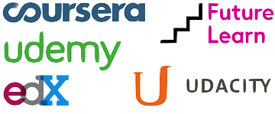
MOOCs
Massive Online Open Courses
Often offered by universities
Most are free
Certificate often available for a small fee
Employees can study at their own pace
Notes:
Ronnie

Slide 17
Edx.org
Notes:
ronnie

Slide 18
Edx.org
Notes:
Ronnie

Slide 19
Benefits and Challenges
Employee Benefit – investing in your people
Broaden scope of available L&D content
Support upskilling and personal development
Not all content is created equal
Need for content review and SME validation
Too much content
Notes:
Rem
When it comes to having a learning knowledge and content strategy, it is going to be a great way to support your employees since this is an investment in the people of your organization. It’s an employee benefit because now you have content that can address a variety of different needs, both at the individual level as well as at the organizational level. By having a learning knowledge and content strategy the LED team can now broaden the scope of available LED content without adding additional manpower and in some cases may be minimal manpower to support these initiatives. But more importantly but hovering these different resources together they give employees the opportunity to upskill themselves and develop key skills that can be used as they continue to think about what’s their next step in the organization as well as in their overall careers. On the negative side we have to always remember that not all content is created equal and when you are looking at third party resources especially it may not necessarily be as detailed or even as relevant as one would like which means it’s important for you to understand your content and to make sure that you understand who is this content for is this constant appropriate to all of my employees or to a subsection of my employees which brings us to the second challenge which means that you need to have your content validated by key subject matter experts in your organization this is a critical piece because you want to make sure that whatever content you are offering it has the blessing as well as the support by key employees in your organization this could be department heads and in other cases it could simply just be top performers that at least can vouch for the validity of the content found within. This also leads to the third challenge which now means you have the unenviable task of having too much content. Which means you have to manage it you have to kind of know what’s out there or at least what’s out there to the best of your ability and when you get a request you are able to provide some guidance around what solutions might make the most sense. Although having too much content is a nice problem to have, it can be time-consuming for both the subject matter experts as well As for the employees themselves if you don’t streamline the content as much as possible so that they can quickly what is most relevant for them in the overall scheme of things

Slide 20
In Conclusion: Developing a Strategy
Notes:
Rem
In short, the learning and development function has always evolved to meet the needs of the organization. The current fallout that we’re seeing from the great resignation and the pandemic simply just mean that the L&D function has an opportunity to be seen not just as content creators but as content curators as well as knowledge and content managers. Which means we need to be able to create a holistic strategy that includes internally created content, purchase content, and third party respurces as part of your overall learning and development strategy this will make sure that leadership understands the role that you are playing towards employee retention, and you’re able to showcase the ways that you can be effective in this area by the use oh a sound learning knowledge and content strategy. This can also be a great opportunity to gain support and funding from organizational leaders who may see content as being cost prohibitive again showcasing what is available what could be available and how it could work if we combine these different pieces together holistically is the way to go so that you can address the various learners and the various needs that an organization has. We can’t boil the ocean and try to solve for every single case but we have an opportunity with a sound learning knowledge and content strategy to be able to provide all of our learners with the opportunity to access these resources and support them as they continue to grow in their current roles and plan for their next steps.

Slide 21
References
Cairns, L.G., & Malloch, M.S. (2011). Theories of Work, Place and Learning: New Direction, Chapter 1 in Malloch, M., Cairns, L.G., Evans and O’Connor, B., The SAGE Handbook of Workplace Learning, London, SAGE Publications.
Chen, D.W., & Catrambone, R. (2014). Effects of Multimedia Interactivity on Spatial Task Learning Outcomes. Proceedings of the Human Factors and Ergonomics Society Annual Meeting, 58(1), 1356–1360. https://draweb.njcu.edu:2095/10.1177/1541931214581283
Chapman, P., Selvarajah, S., & Webster, J. (1999). Engagement in multimedia training systems. Proceedings of the 32nd Hawaii International Conference on System Sciences. Maui, HI, USA.
Edsmart (n.d.). Great Resignation Statistics. https://www.edsmart.org/the-great-resignation-statistics/
Hase, S. & Blaschke, L. (2022). Heutagogy, Work and Lifelong Learning. In M. Malloch, L. Cairns, K. Evans, and B. O’Connor (Ed.), The SAGE Handbook of Learning and Work (pp. 80–98). Sage Publishing.
Lawson, A. P., & Mayer, R. E. (2021). Benefits of Writing an Explanation During Pauses in Multimedia Lessons. Educational Psychology Review, 33(4), 1859–1885. https://draweb.njcu.edu:2095/10.1007/s10648-021-09594-w
Mayer, R. C. (2021). Multimedia Learning.
Mayer, R. E. (2014). The cognitive theory of multimedia learning. In R. E. Mayer (Ed.), The Cambridge handbook of multimedia learning (2nd ed., pp. 43–71). Cambridge University Press. https://doi.org/10.1017/ CBO9781139547369.
O’Connor, B., Lynch, D. (2011). Partnerships between and among education and the public and private sectors. In M. Malloch, L. Cairns, & K. Evans The SAGE handbook of workplace learning (pp. 407-419). SAGE Publications Ltd, https://dx.doi.org/10.4135/9781446200940.n30
Whatfix (2021, October 11). Learning and Development (L&D) Trends to Watch in 2023.

Slide 22
Thank you!
Ronnie O’Neill Ed.D.
voneill327@gmail.com
Remberto Jimenez Ed.D.
remjim14@gmail.com

